Slide 1
Visual Analytics of Atmosphere Pollutants in Near Real-Time
Livia Mano
Master Colloquium
12/01/2021

Slide 2
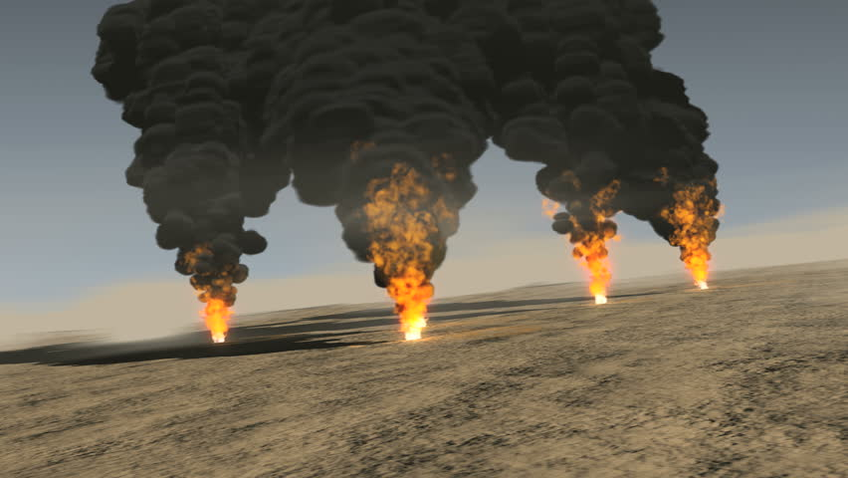
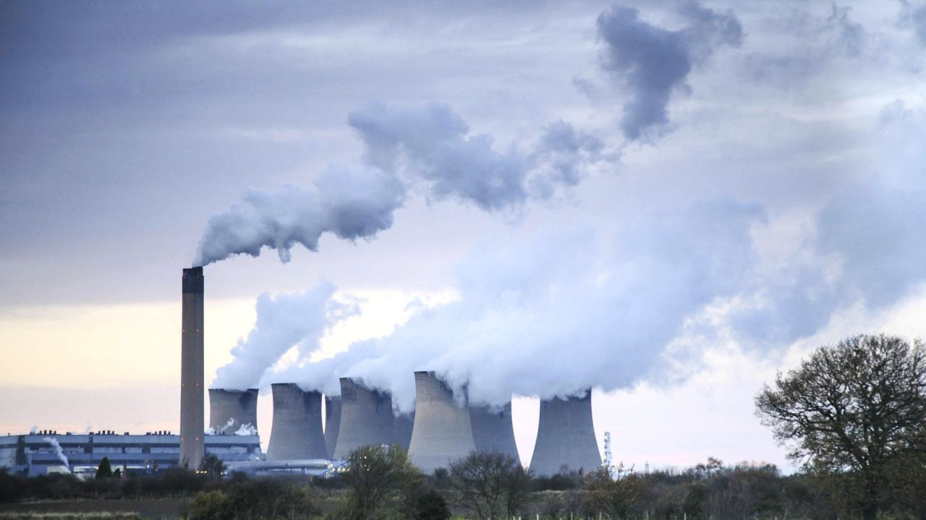
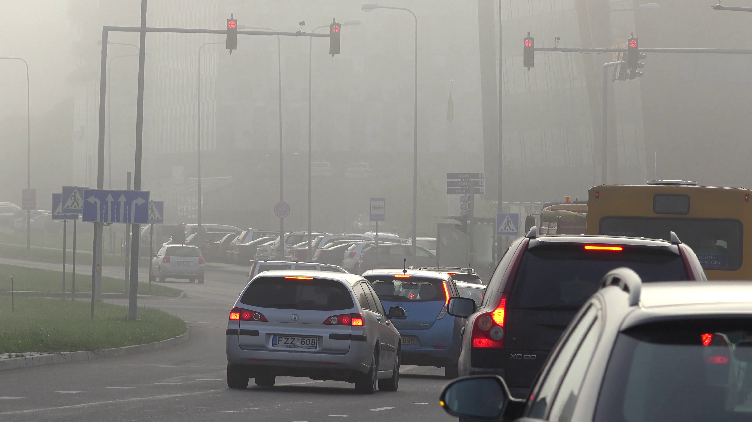
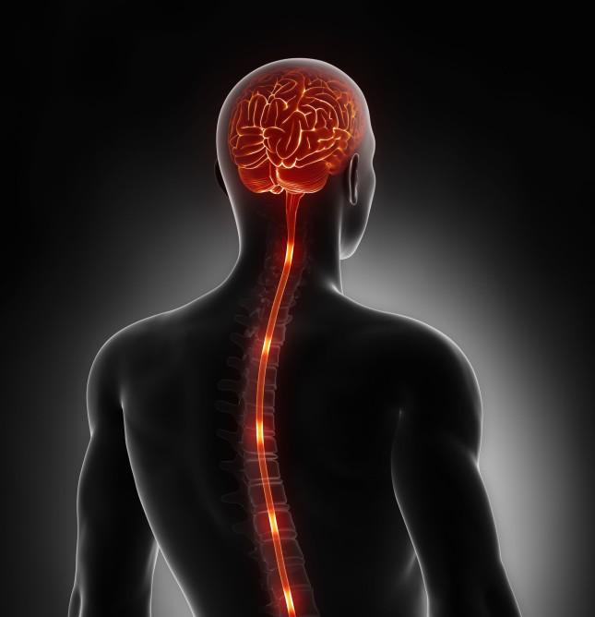
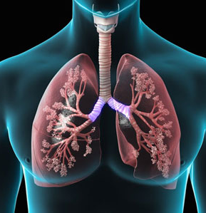
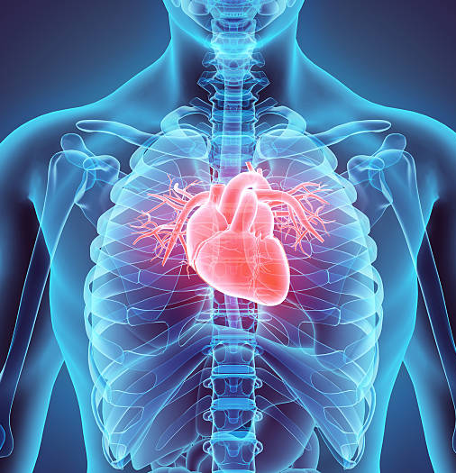
Air Pollution
Notes:
Motivation behind this thesis is the increased air pollution levels
Air pollution has severe negative effects not only in health, like causing neurological, respiratory and heart diesieses,
But also impacts other areas like envirenment, economy etc.

Slide 3

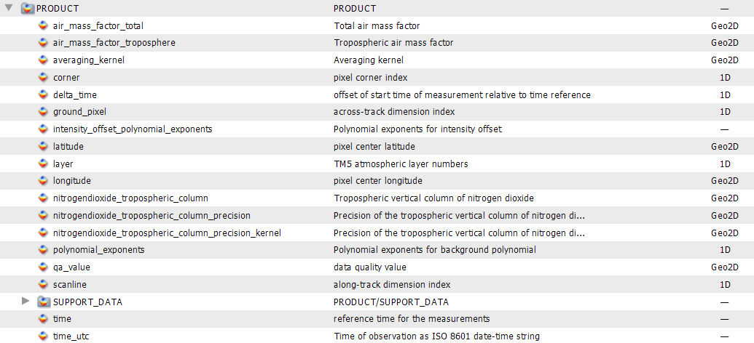
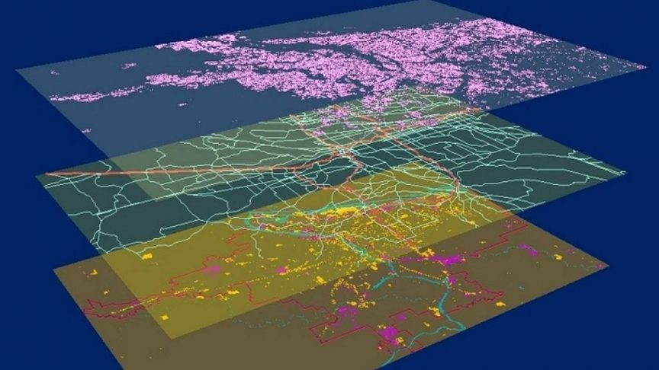


Motivation
+
Large spatio-temporal datasets
Visual means for data exploration
Insights, Findings and correlations
Notes:
Studying air pollution is essential In order to address these issues.
Scientists and domain experts need to analyze air pollution data, and extract interesting findings and correlations
These findings can then be used for further decision making.
Examples: ban of diesel vehichles, traffic regulations, factory regulations.
Air pollution data can be large, due to many sources and available attributes.
Visualy exploration is necessary to simplify and help the process of analyzis.
Scientists and domain experts need to be equiped with visual tools.

Slide 4
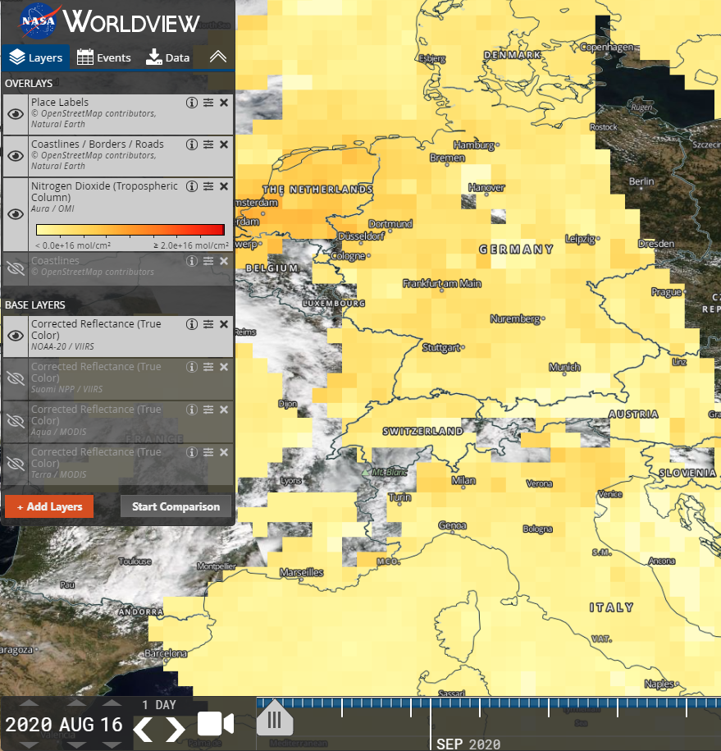
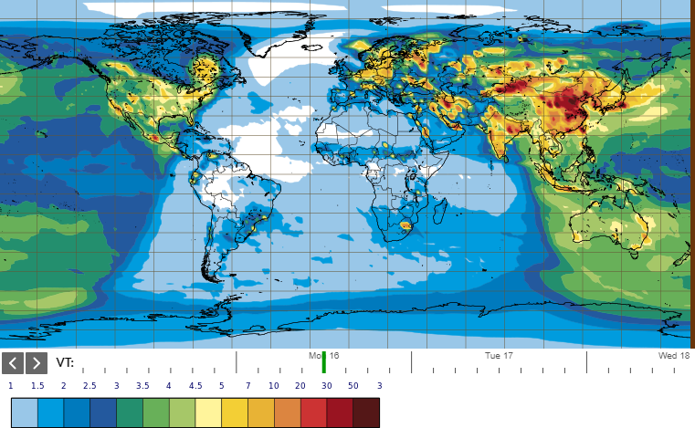
Related Work
WorldView by NASA 1)
CAMS by ESA 2)
1) https://worldview.earthdata.nasa.gov/
2) https://atmosphere.copernicus.eu/https://atmosphere.copernicus.eu/
Notes:
Two of the biggest space agensies, NASA and ESA provide their own visual tools for data exploration of their own missions,
Respectively, worldview, for exploring air related missions like MODIS,
And CAMS, for exploring air related missions like SENTINEL-5P.
Both of these examples shown in this slide provide very limited functionalities in terms of data exploration in depth. The CAMS system does not have a zooming feature, or requesting specific regions.
The WorldView system provides zooming until a certain resolution, making it unsuitable for exploring lower levels.
Both systems suffer from readibility

Slide 5
Challanges/ Requirements
Handle of big data sets and data volume [1]
Comparison of spaces and time [1]
Level of detail on demand [1]
Notes:
Following some of the challanges raised by literature
Visual Analytics features collected from literature [1], [2]
We compiled a list of requirements that would be adressed during the work of this thesis
Scalability
Comparison
Level of detail

Slide 6
Contribution
Near Real-Time processing and visual analytics
A scalable automated data pipeline
A web-based visualization application
Two detailed use cases for illustrating the use of the application
Notes:
The main contribution of this thesis is presenting a solution for near real time processing and visual analytics of air pollution data
To fullfil this goal, we implemented a web based visualization application,
build on top of the an existing backend solution for automatic data download and preprocessing of remote sensing air pollution data
This solution is evaluated by creating and illustrating two use cases in detail

Slide 7
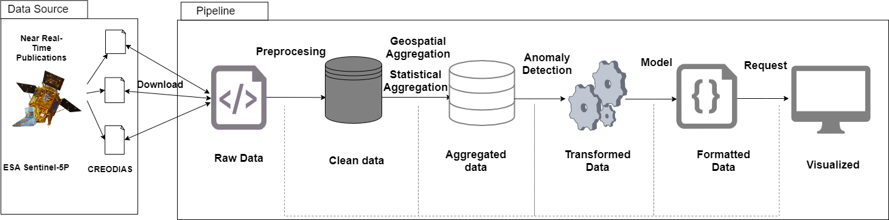
Automated Data Pipeline
Notes:
The first part of our tool consists of an automated data pipeline that automatically integrates remote sensing data into the tool.
The pipeline was created during the master project phase, and it‘s goal is to automatically query and download new daily air pollution data, as well as process this data until it‘s formated for visualization [CLICK]

Slide 8
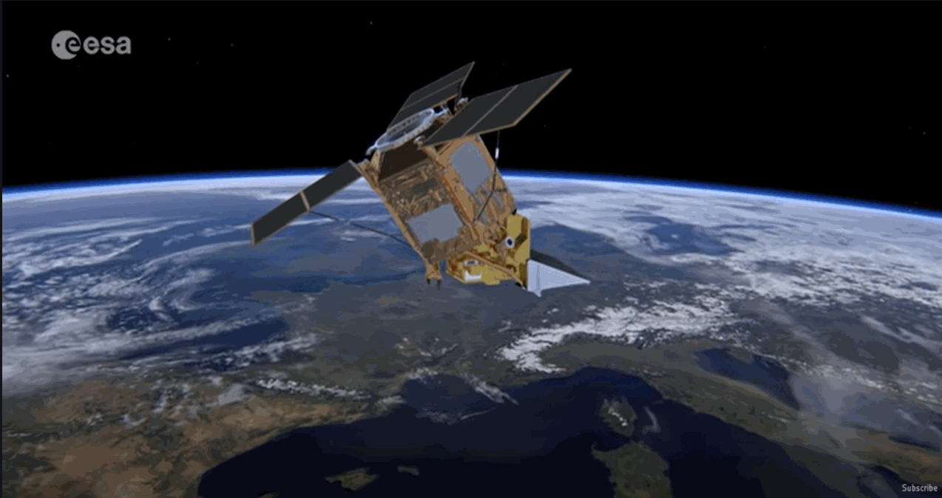
Data Download
Sentinel 5P ESA. Launched in 2017
NOx, SOx
Daily recordings and publications
Attributes:
Coordinate(long/lat),
Product value
Quality Assurance
Time
Notes:
The first step of the pipeline is the Download phase.
We chose the ESA‘s space mission Sentinel 5P as our data source. This mission was launched in 2017 and it records daily levels of products like nirogen oxides, sulphur oxides, which are named by WHO as being most influential in air pollution.
The mission is releasing new data daily, with a resolution 7x7 km
data consists of a variety of complex attributes and hierarchies. The attributes of interest for this thesis are Location, Product Value, Quality Assurance and Time.

Slide 9
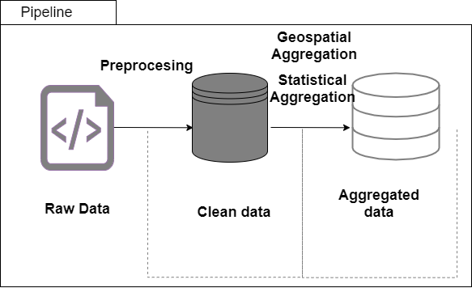
Preprocessing
Removing points with QA < 50
Spatial Aggregation: points -> polygons/regions
Statistical Aggregation: daily averages for each city
Notes:
The second step of the pipeline is the preprocessing step, where the data is cleaned and formated.
We clean out data points with a QA value lower than 50, as per Sentinel guideline
Additionally we perform some aggregation steps. Firslty we join single data points into polygon objects, after german administrative units.
Secondly, we aggregate daily averages for polygons, thus creating individual time series for each city

Slide 10
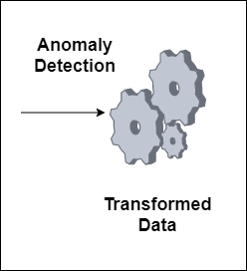

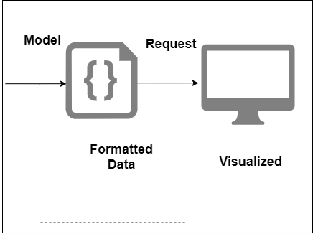
Data Transformation
Input
time series
(date, value)
Anomaly Detection
Output
anomaly objects
(date, value)
GeoJSON objects for web presentation
Notes:
After having a cleaned data set, we input time series for each city into the anomaly detection algorithm, which then outputs anomalie objects, consisting of the date of the anomaly and the value
Laslty, the data gets formated into GEOJSON objects, which is a web standart for displaying spatial objects. The front end visualization tool requests data via a REST interface

Slide 11
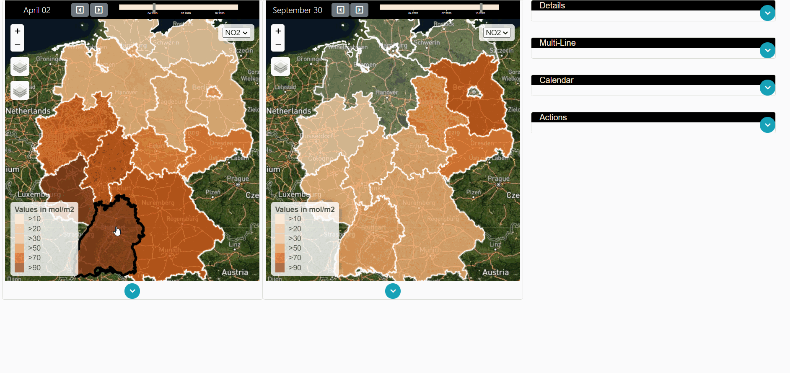
Visualization Application
Notes:
In order to present the data to the user and for further data navigation, we build a visualization tool
Consisting on a variety of visual components for displaying spatial and temporal dimensions
I present each component in detail

Slide 12
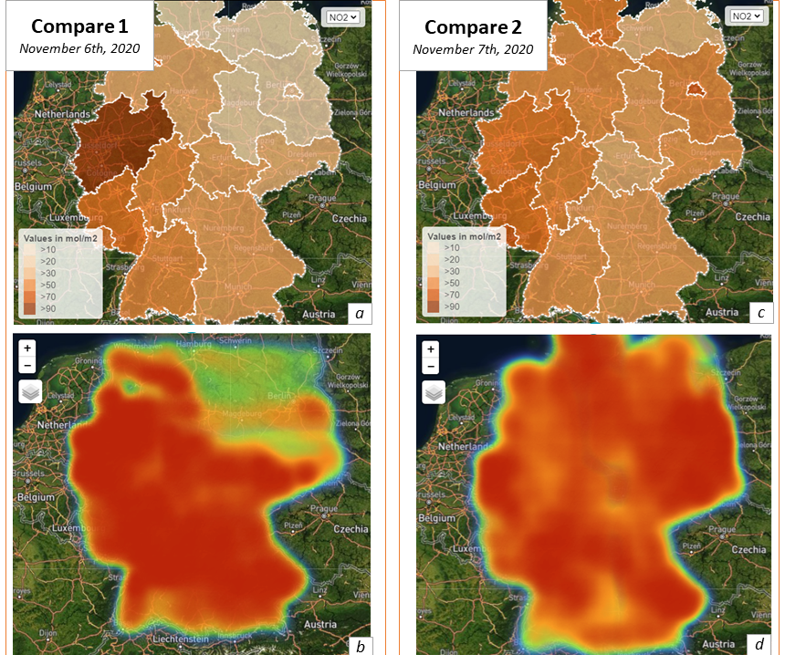
Visual Components
Maps for spatial information
Two comparison components
Select and compare different dates
Notes:
The spatial attributes are visualized in maps. We include two types of maps
Choropleth maps for geopolitical seperation
Heatmaps for a general non-aggregated view of the most polluted or „heated“ regions
There are two sets of each maps. A set or a compare component consists of a day selection slider, that sets the selected date for a choropleth and a heat map
The two components are seperated from each other,
Meaning the user can initiate a comparison mode by selecting two different points in time, and exploring the same physical space.

Slide 13
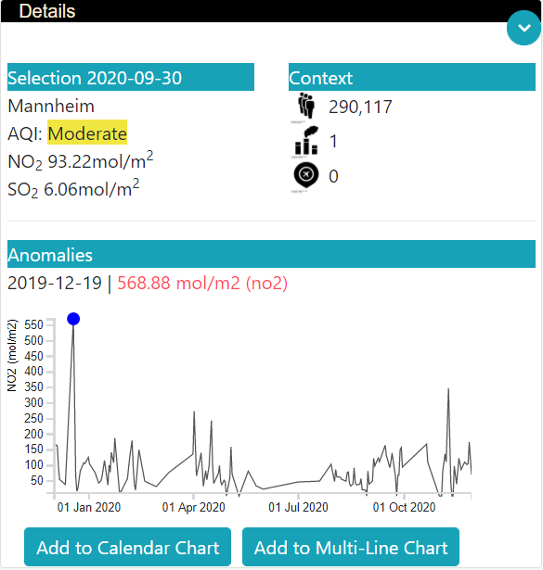
Visual Components
Notes:
The detail view is activated on each map polygon click
It displays details of the clicked polygon, like the daily product values, the daily AQI calculation
It displays a list of contextual information, like population number, number of factories, and number of airport facilities,
These infomation is displayed here to help the user with a portrait of pollution sources
The second part of the detail view is a line chart displaying all the daily product values of the selected city
Annomalies are displayed on the chart, as well as on a detailed table, with the date and the anomaly value

Slide 14
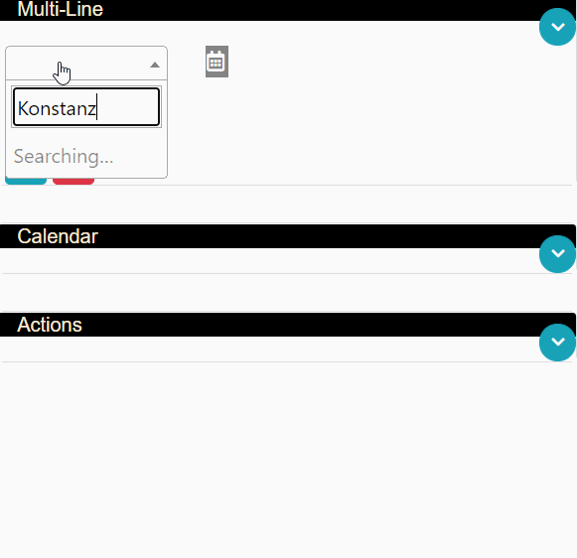
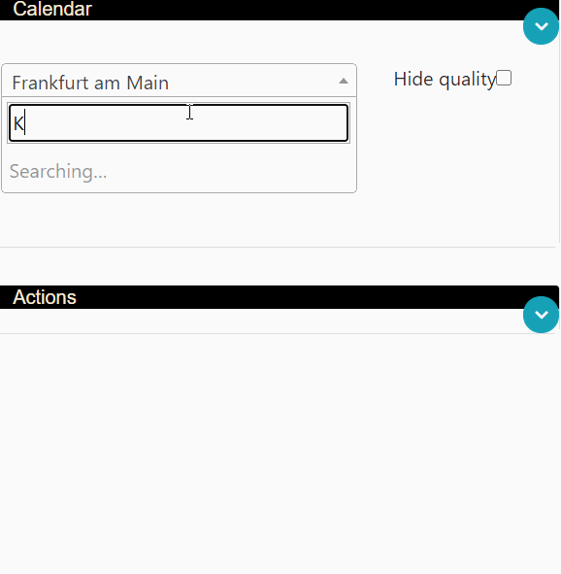
Visual Components
Multiline and Calendar View for time series
Display time series for selectable regions, for different air products
Notes:
To visualize the temporal dimensions, we implemented two visual components
The multiline chart displays a line chart of the average daily product value of a selected city
The user can select and display multiple cities
The chart allows for zooming, filtering, and range selection
The chart is equiped with a table showing the average product level for each city for the selected range
The calednar view displays the time series of a selected city as a calendar form
Month seperation is more visible
Each calendar cell is color encoded to the product value
Each cell contains a smaller white cell, size encoded to the quality of the recording

Slide 15
Evaluation
Expert requirements during the planning of the thesis
Building use cases to steer the future requirements and design of the tool
A large user study, with non expert user, is not feasible, and does not produce meaningful results.
Unable to gather expert domain feedback post development
Notes:
During the planing phase of this thesis, we consulted with a domain expert, who provided feedback on the direction this thesis could take, as well as the evaluation of it.
Their feedback consisted on focusing on builing few use cases, and create requirements for the tool, following these use cases
The evaluation of the solution presented so far is done by creating and illustrating two potential use cases, with specific tasks that can be solved by interacting with the tool
Conducting a user study was not feasible in this scenario, mainly due to the fact that unless the participants were domain experts, the results of the study would have been scatered and not meaningful.
Furthermore, giving the exploratory nature of the tool, contucting a large qualitative study for general spatio temporal visual analytics would require time and resources to complete.
Reaching out for domain expert evaluation post development resulted to be unsucessful.
In this case, we proceded with the creating of two use cases [CLICK]

Slide 16
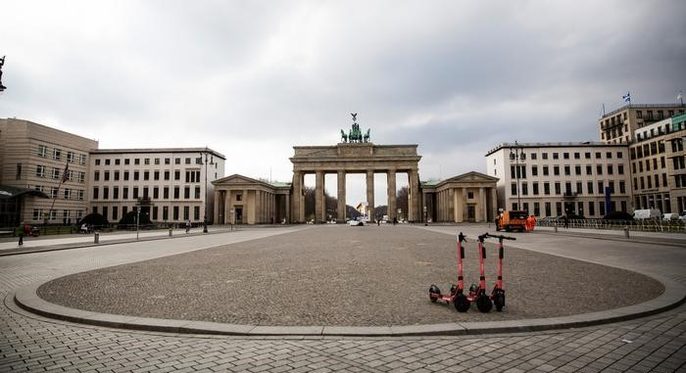
Use Case 1
Global lockdown changed the routine of people, businesses, governments
Reports from China[2] and Italy[3] indicate a decrease of air pollution
Explore changes in air pollution in Germany
Lockdown period: Spring 2020 – Summer 2020
Notes:
The first use case is build around the past year events revolving around the global pandemic
The pandemic effected heavily in changing the routine of all people, businesses and governments around the world.
Following some initial reports and studies conducted in China and Italy, which revolved around the increase of air pollution, we builded a use case focusing on Germany
There was a lockdown period approximately between middle of spring (march, april) to the end of summer (August)
This use case focuses on exploring the effects that the lockdown had on air pollution in Germany

Slide 17
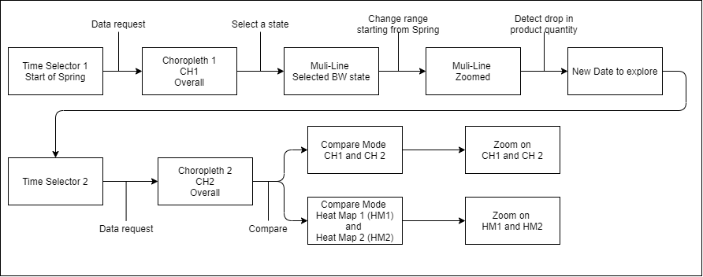
Interaction flow example

Slide 18
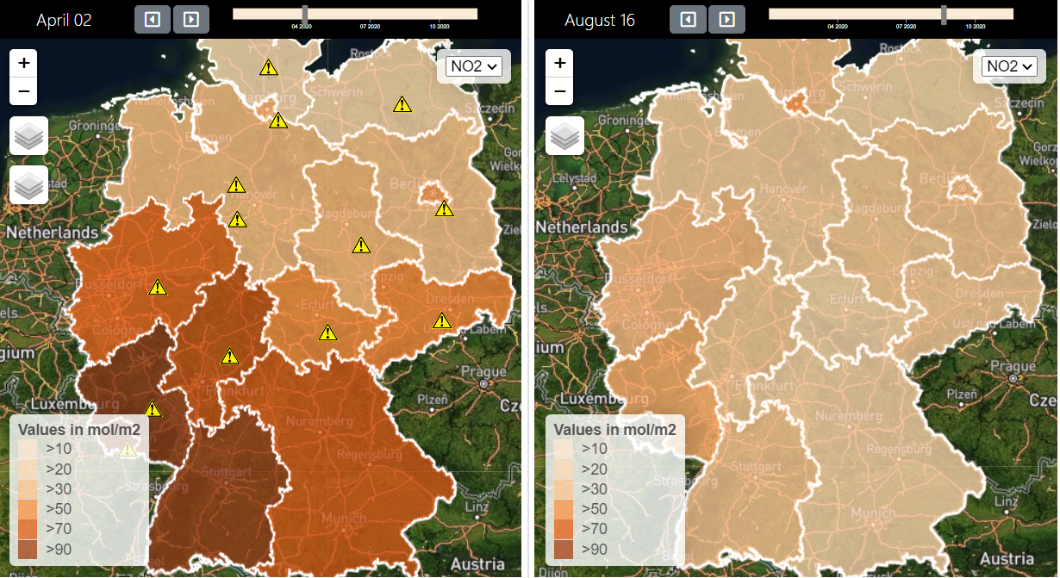
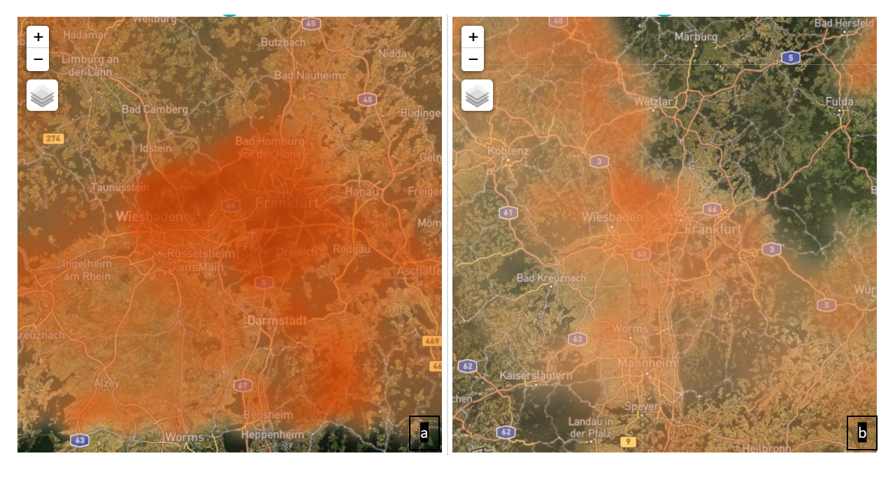
Findings
Q: Can an air pollution level drop be detected by comparing two dates?
Notes:
Compare two or more cities or regions. Is there a similar drop pattern in air
pollution?
We manually select two dates in April and august, and explore the NO2 product levels on the map components. The choropleth map shows A drop in air pollution all over Germany.
We zoom-in on the heatmap and explore the region of Hesse. A difference in pollution level is visible, with the map showing a lower and more neutralized distribution of "heat" (pollution levels).

Slide 19
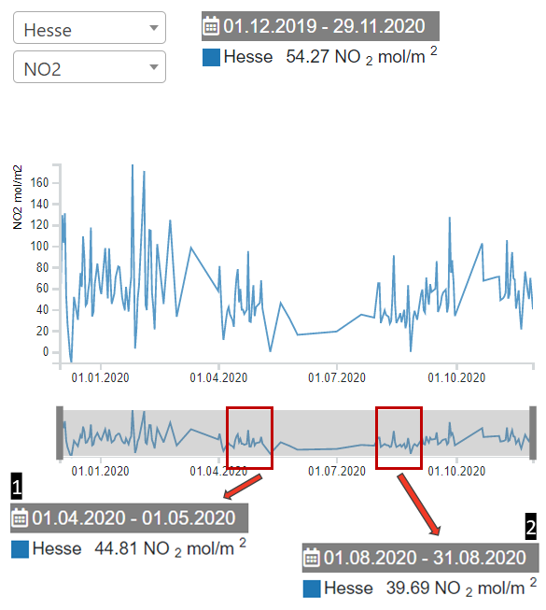
Findings
Q: What is the average pollution level during a selected date range?
Notes:
Manually detect a pattern in which there was a decrease in air pollution. What
is the average pollution level during a certain date range?
After manually searching the multi line chart for a decrease in air pollution, we request the data from the detected date onto the second map. A drop in air pollution is visible around all Germany.
We again turn to the multi line chart for calculating the average pollution for the month of April (pre lockdown) and the month of August (post lockdown).
There is a drop in the average value, with August having a value of 39.6 NO2 mol/m2, compared to the overall average for HESSE which is 54.27

Slide 20
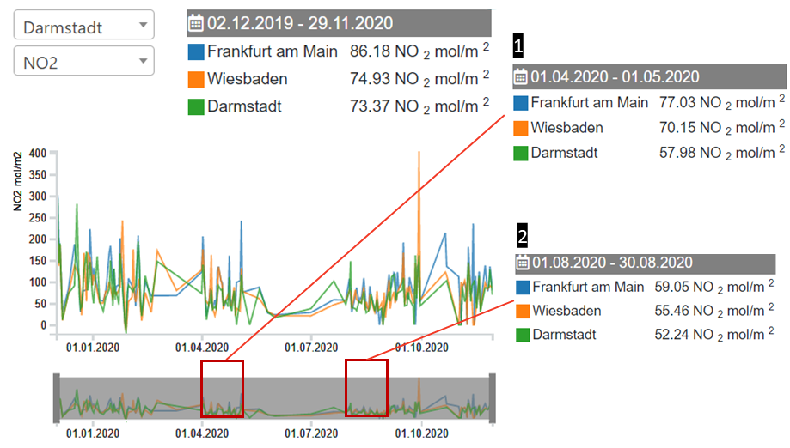
Findings
Q: Can an air pollution level drop be detected in various cities?
Notes:
In this illustration, three cities around the city of frankfurt are chosen for a detailed exploration on the multi line chart. The user can gain insights about the overall pollution levels, as well as pollution during a selected time range

Slide 21
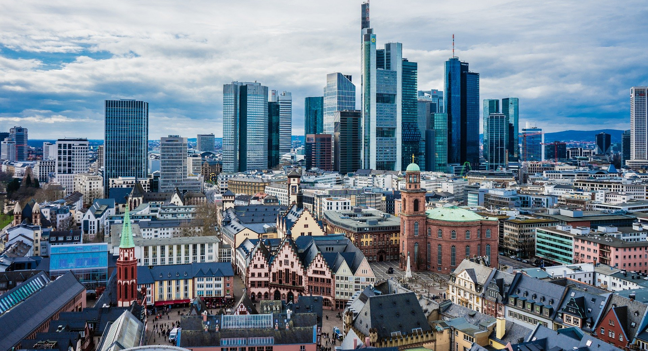
Use Case 2
Regional historical data exploration, of one or more selected cities
Personal or work related motivation
Notes:
The second use case is designed to solve the quest of exploring more in depth the historical progress of one or more cities
In this scenario the user or the interested party is binded to a city or region, due to work, life, education ect.
They wish to explore the trends of pollution around this city or region

Slide 22
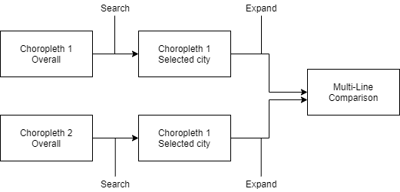
Interaction flow example
Notes:
In this chart

Slide 23
Findings
Q: What is the least polluted city around an area?
Notes:
In this illustration, three cities around the city of frankfurt are chosen for a detailed exploration on the multi line chart. The user can gain insights about the overall pollution levels, as well as pollution during a selected time range

Slide 24
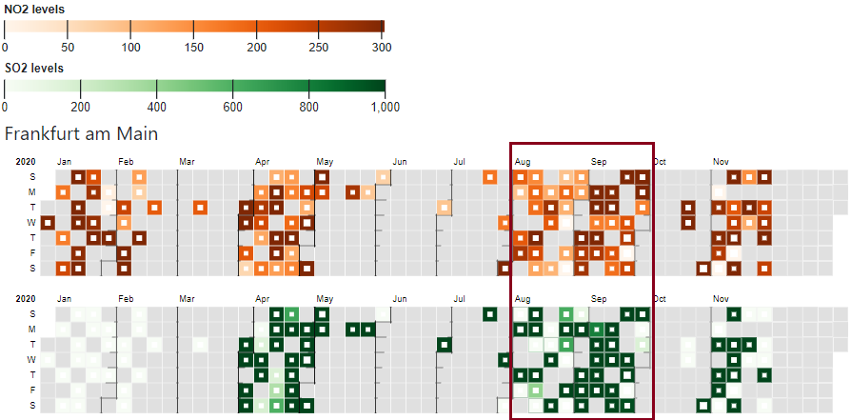
Questions and Findings
Q: Can patterns be observed for a selected city?
Notes:
Can patterns be observed? Can patterns be related to seasonality?
Frankfurt am Main selected on the calendar view. We focus on finding patterns for August and September. While the \ce{SO2} data is very skewed, with extreme ranges, the \ce{NO2} data can be distinguished better. We cannot detect patterns for weekdays, like weekend days having a lower \ce{NO2} concentration. We can detect a difference in values between the two months.

Slide 25
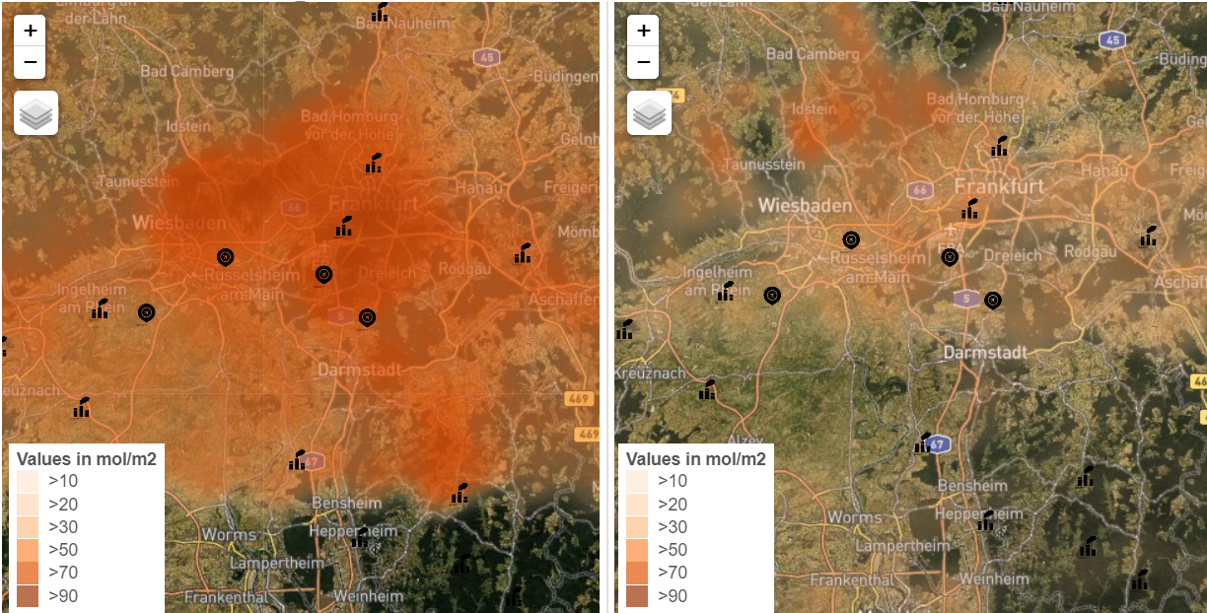
Questions and Findings
Q: Is there a significan decrease in air pollution in areas around points of interests?
Notes:
Explore areas near to contextual points. Is there a significant decrease in air pollution in the areas surrounding these points?
Contextual geographical objects, factories, and airports, displayed on the heat map, near Frankfurt and Wiesbaden,
data selected for 02.04.2020 and 16.08.2020. We expect this area to have high pollution due to being populated with various industries. We can observe that typically that is the case (from the left map)

Slide 26
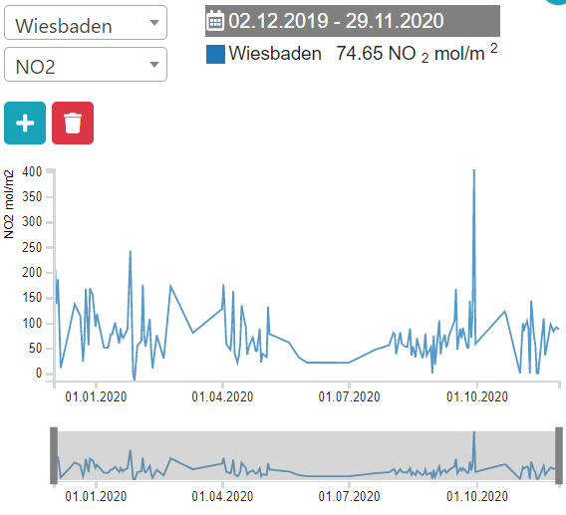
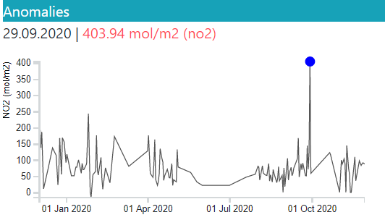
Findings
Q: Are the results of the Anomaly Detection meaningful?
Notes:
Are the results of the Anomaly Detection meaningful?
During the exploration of detail view for the city of Wiesbaden, we notice a detected anomaly, a high spike occurring on Sept 29. We check the multi line chart and notice that the anomal record with a value of 400 mol/m2 differs significantly from the average value for Wiesbaden (74)

Slide 27
Future Work
Expert evaluation
Integrate other data sources (MODIS, ground stations)
Integrate more air products (PM10, CO, Ozone)
Automatic pattern detection
Notes:
For future works and improvements of this thesis, firstly its necessary to focus on completing the evaluation process of the work done so far, by requiring expert evaluation and feedback.
In order to complement the existing data and increase the reliability of the tool, we can take steps for integrating additional data sources, like another remote source or ground station data.
The data pipeline required little additional development for reading new sources, while the rest of the steps are already scalable.
Additional air products can also be integrated in accordance to the available sources. This would improve the AQI calculation
Lastly, more work can be done in the direction of fully or partialy automating pattern detection, for increasing user experience, and steer the user‘s exploration into meaninfgul insights

Slide 28
Summary
Near Real-Time processing and visual analytics
A scalable automated data pipeline
A web-based visualization application
Two detailed use cases for illustrating the use of the application
Notes:
The main contribution of this thesis is presenting a solution for near real time processing and visual analytics of air pollution data
To fullfil this goal, we implemented a web based visualization application,
build on top of the an existing backend solution for automatic data download and preprocessing of remote sensing air pollution data
This solution is evaluated by creating and illustrating two use cases in detail

Slide 29
Thank you!
Notes:
Any Question?

Slide 30
Bibliography
[1] Andrienko, Natalia, Gennady Andrienko, and Peter Gatalsky. "Exploratory spatio-temporal visualization: an analytical review." Journal of Visual Languages & Computing 14.6 (2003): 503-541.
[2] Alamo, Teodoro, et al. "Open data resources for fighting covid-19." arXiv preprint arXiv:2004.06111 (2020).
[3] Fattorini, Daniele, and Francesco Regoli. "Role of the chronic air pollution levels in the Covid-19 outbreak risk in Italy." Environmental Pollution (2020): 114732.

Slide 31
Air Particles
Nitrogen Oxides (NOx)
Sulphur Oxides (SOx)
Ozone (O3)
Carbon Monoxide (CO)
Carbon Dioxide (CO2)

Slide 32
Discussion, Challanges, Future Work
Missing data, satellite not recording on certain months for technical reasons
Domain expert feedback
Automatic pattern detection
Integrating more air products (CO, Ozone)
Integrating other data sources (MODIS)

Slide 33
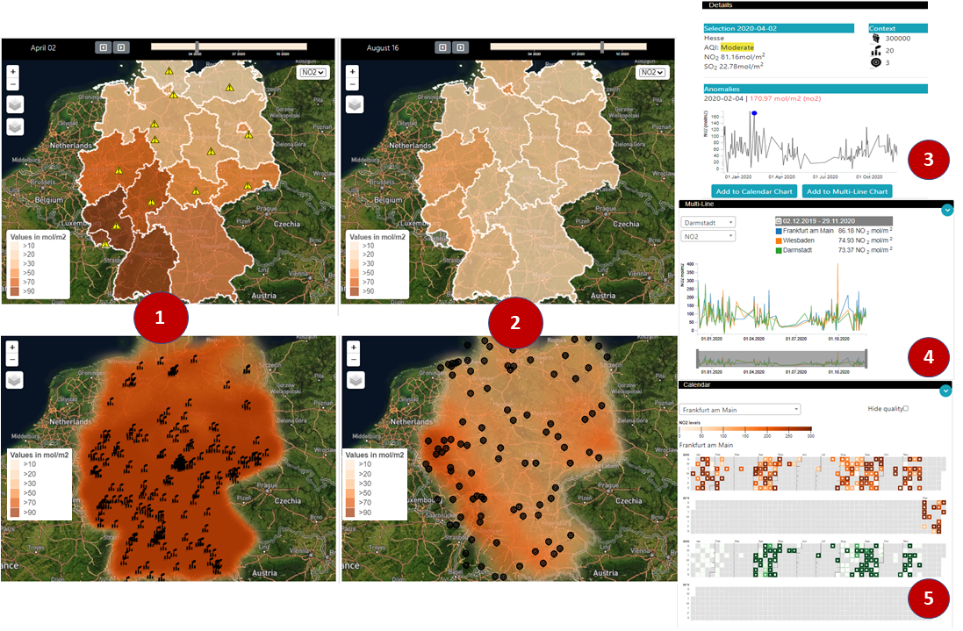
Visualization Application
Notes:
In order to present the data to the user and for further data navigation, we build a visualization tool
Consisting on a variety of visual components for displaying spatial and temporal dimensions
I present each component in detail

Slide 34
Requirements
Visual Analytics features collected from literature and from expert communication
Level of detail
Comparison of spaces and time
when -> where + what
Where + what -> when
Notes:
Following some of the challanges raised by literature
We compiled a list of requirements that would be adressed during the work of this thesis

Slide 35
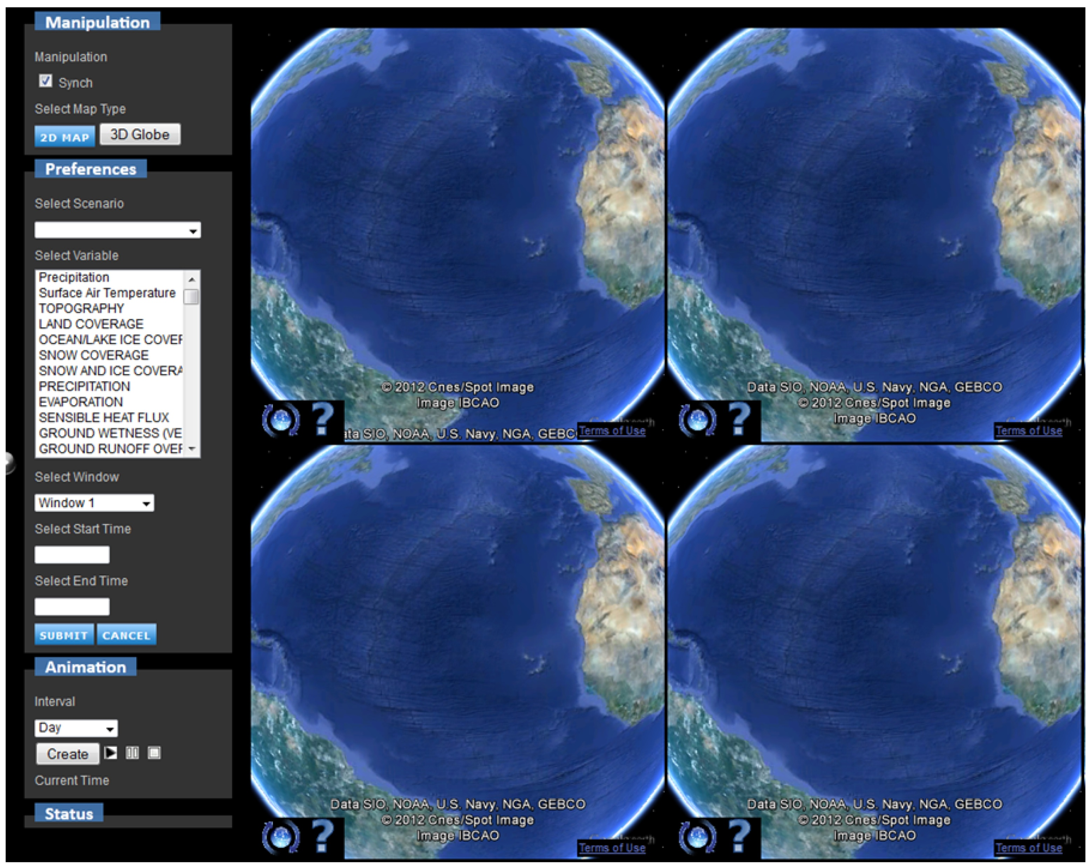
Related Work
Web-Based Geovisual Analytical System for Climate Studies, Sun, Min, et al. [1]
Notes:
GIS for analysing data from various domains –
Generalized, manual data entry
ArcGis, Tabelau
Space agensies provide some visual tools –
Not equiped with features for visual analytics and data navigation.
WorldView, ESA

